Slide 1

Gilbane VDC R&D Script

Slide 2
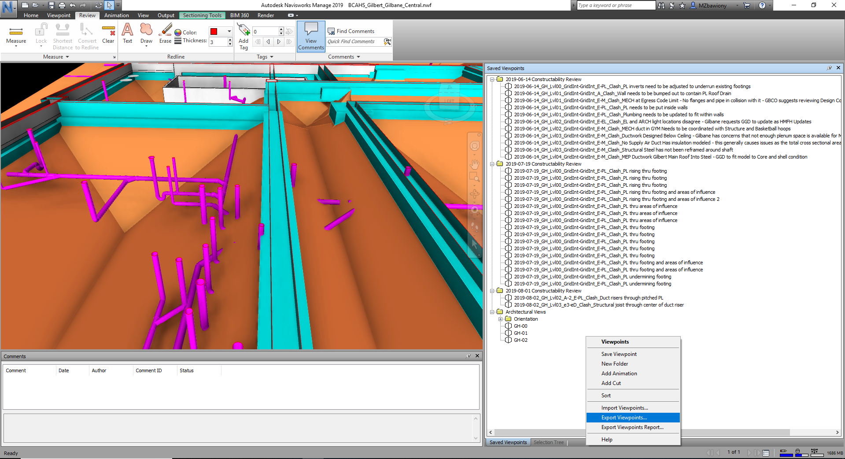
In Navisworks, export an XML of viewpoints by right-clicking inside the “Saved Viewpoints” tab and selecting “Export Viewpoints…”.

Slide 3
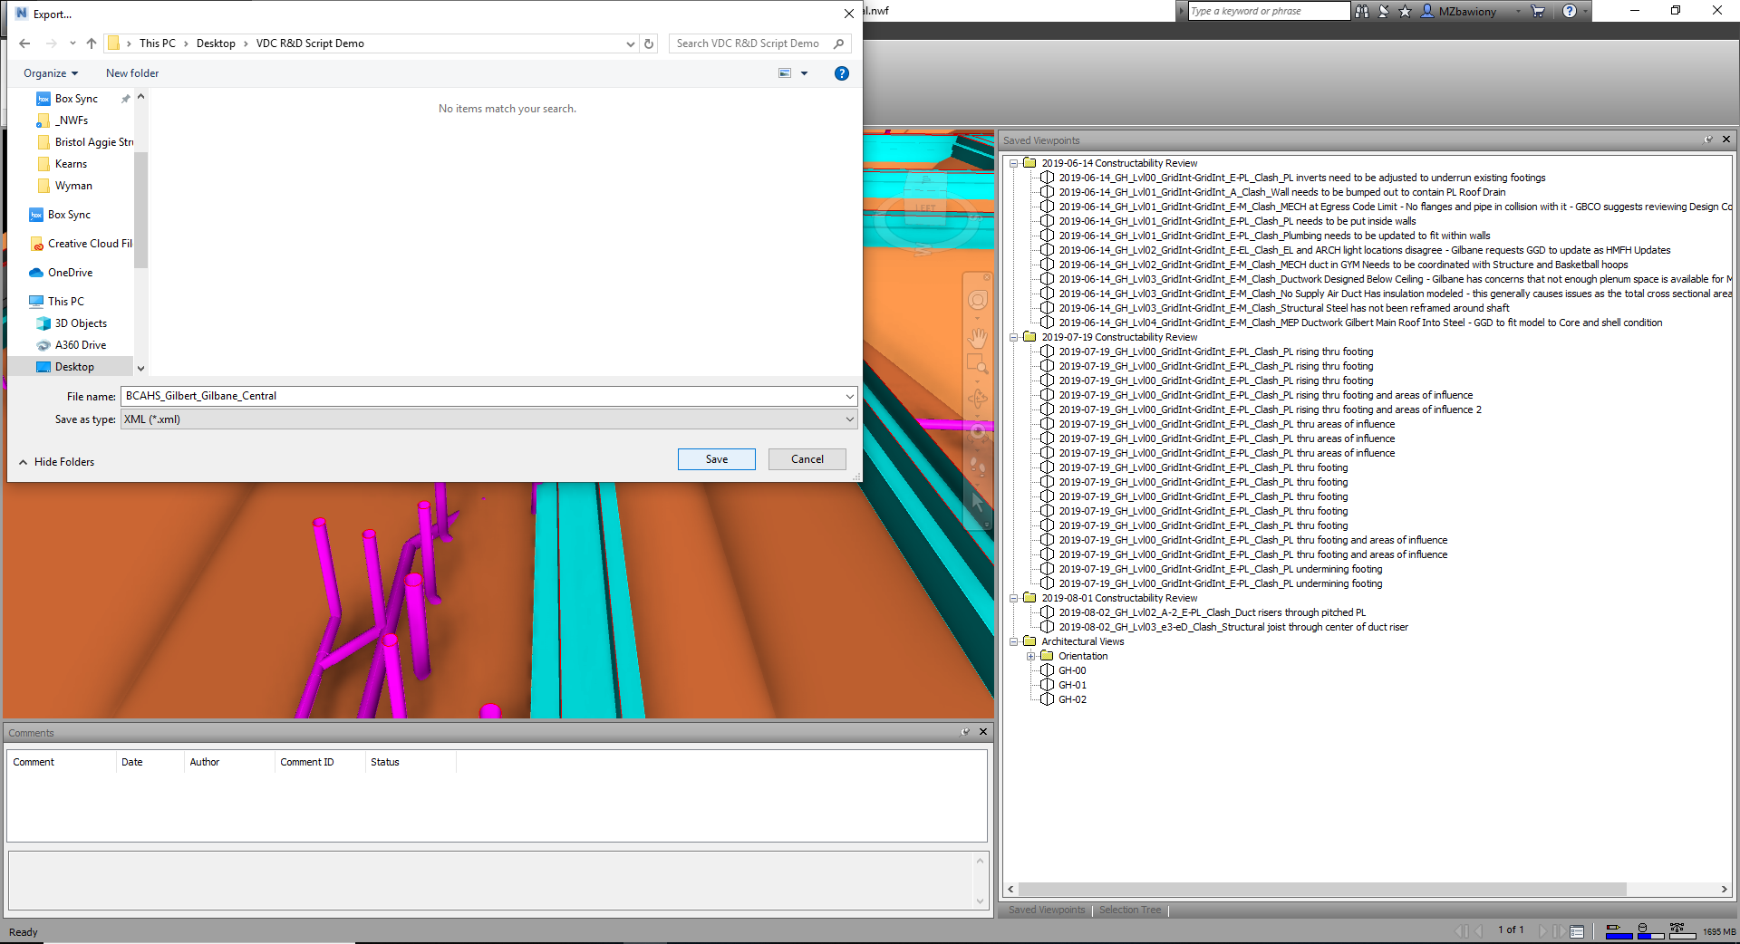
Choose a place to save the XML file, and then click “Save”.

Slide 4

Next, export a viewpoint report by right-clicking in the “Saved Viewpoints” tab and clicking “Export Viewpoints Report…”

Slide 5
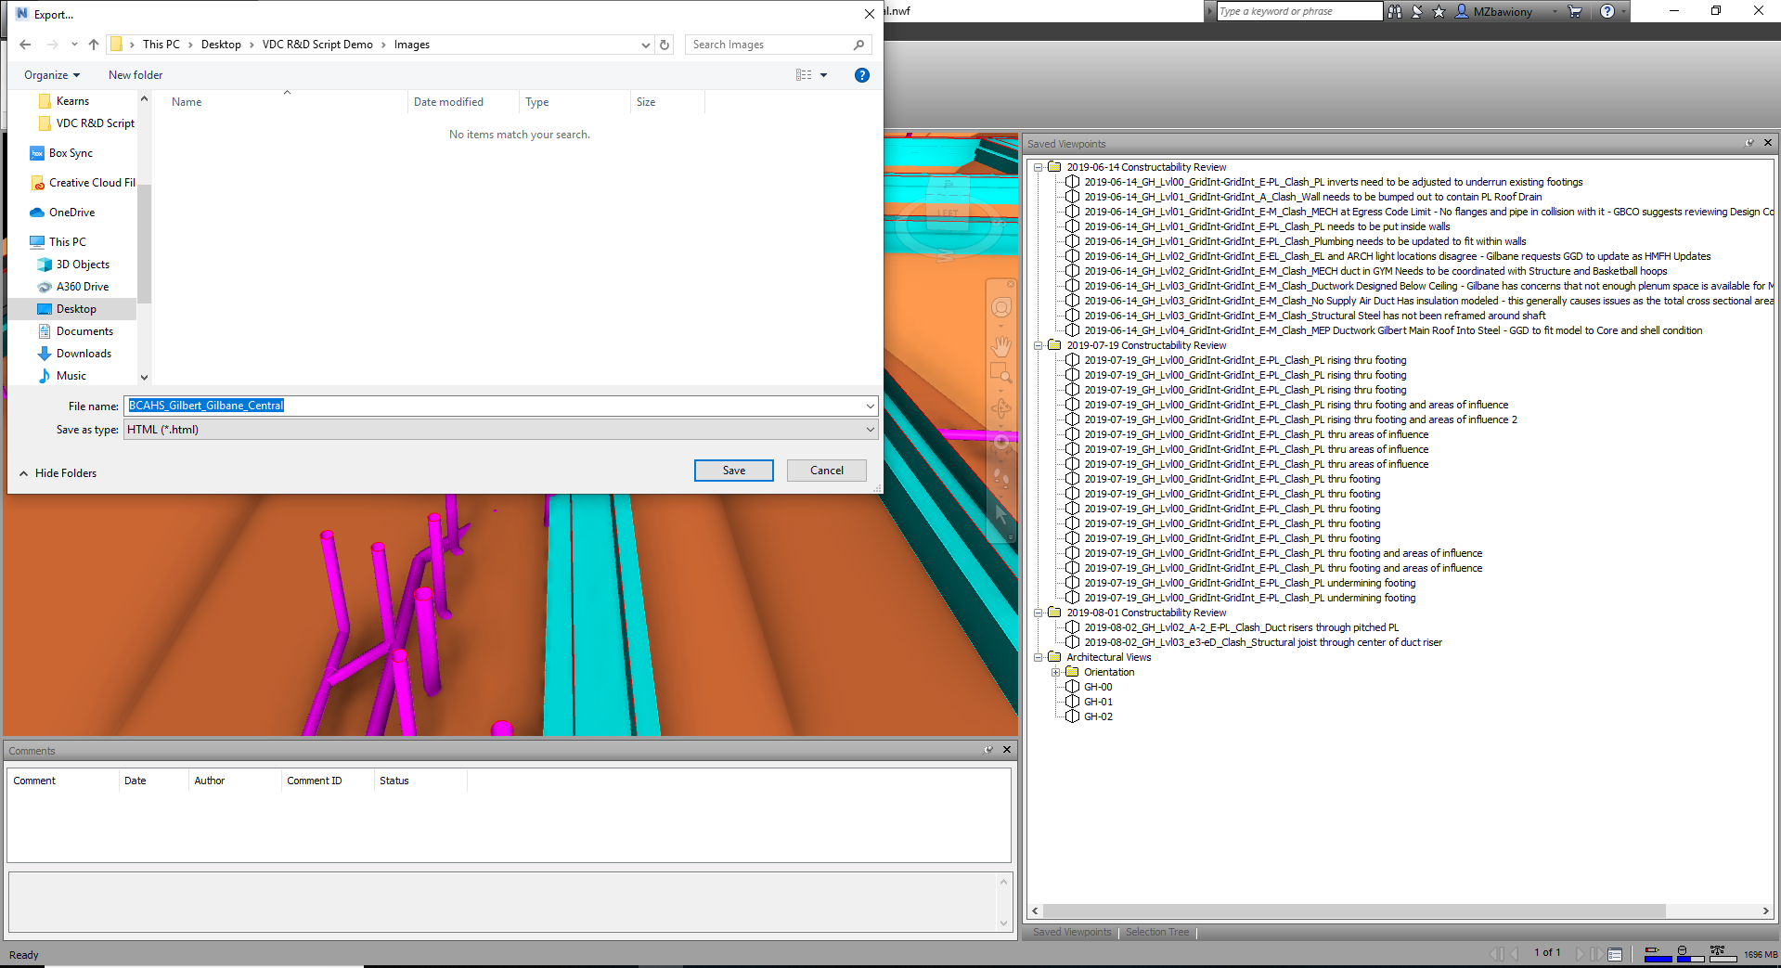
Create an empty folder wherever you want to save the images and hit “Save”
*All images must be saved in an empty folder for the script to work*
I suggest creating a new folder named “Images” or “Images to Upload” in the same place you saved the XML File and then saving the images to that folder.

Slide 6
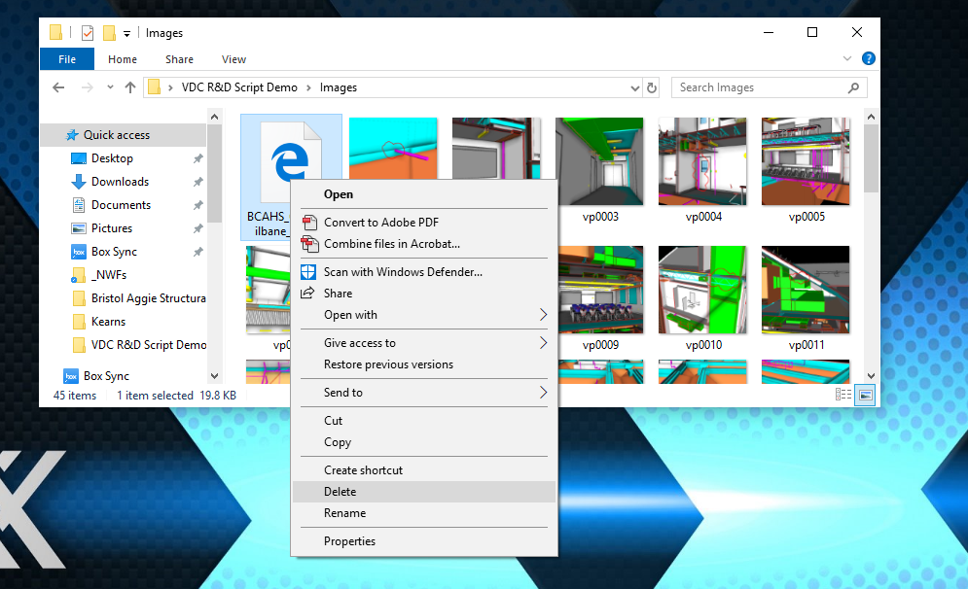
After saving all the images, open the new folder and delete the “.html” file inside. This file should be the first file in the folder.

Slide 7
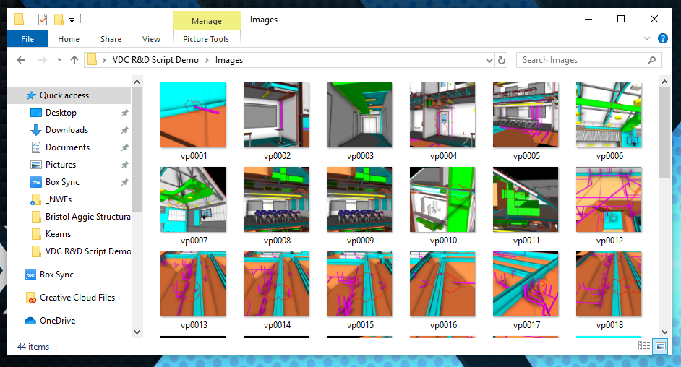
After deleting the “.html” file, here is what your image folder should look like. This folder should only contain the images from the viewpoint report.

Slide 8
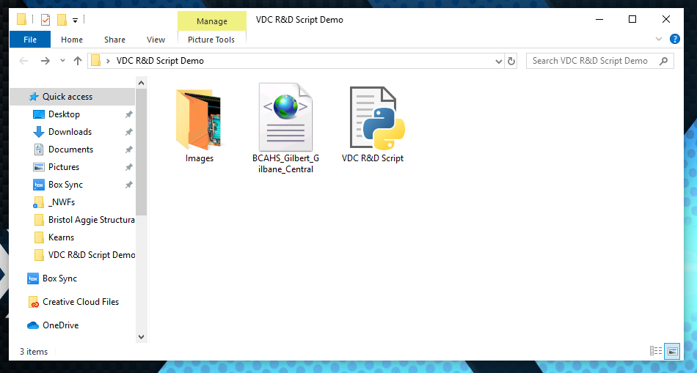
I suggest saving everything in one place and then moving it once you are done. Here is what my working folder looks like at this point in the process.
1) I have a folder strictly filled with images from the viewpoints report
2) I have an XML File
3) I have the Python script for easy access

Slide 9
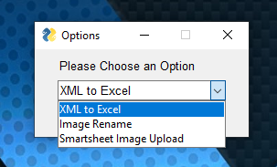
Now that you have exported everything from Navisworks, open the script.
If prompted, choose to open this file with “Python”.
There are 3 options to choose from when you open the program.
The first step should generally be “XML to Excel”
This will create a new Excel sheet that populates the Excel file with the information from your “Saved Viewpoints” tab in Navisworks

Slide 10
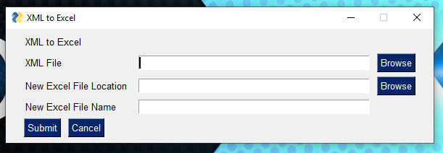
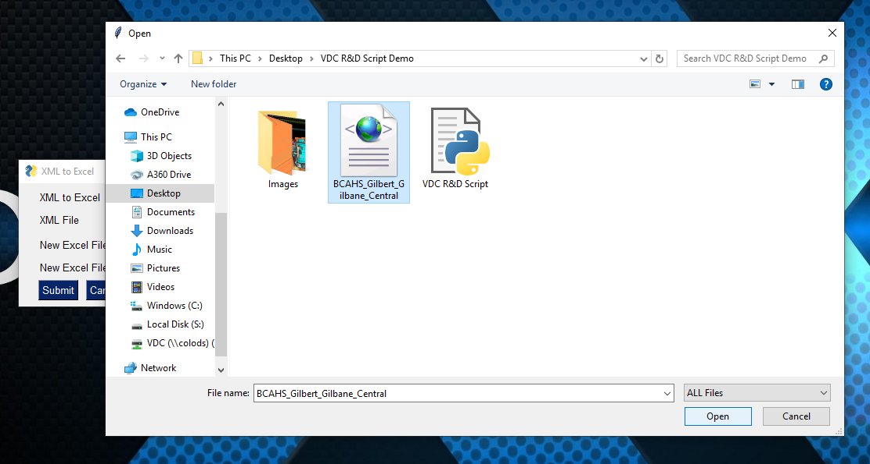
Enter all 3 sections of information, otherwise it will not work.
Use the “Browse” button to navigate to the XML File your exported from Navisworks and select “Open” at the bottom right.

Slide 11
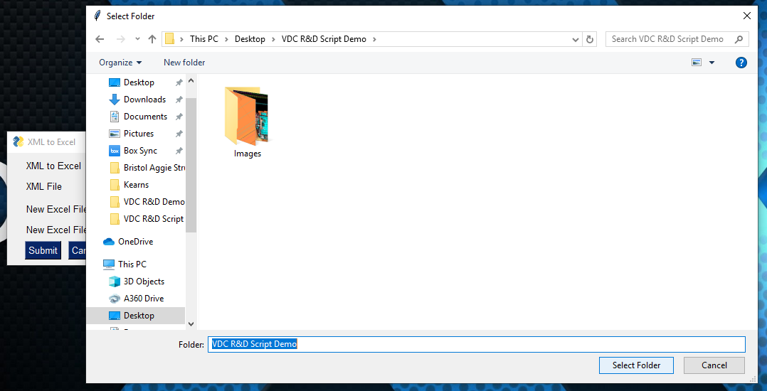
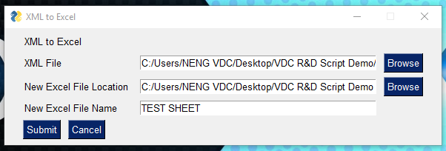
Use the “Browse” button to select where the new Excel File will be created and click “Select Folder” when done.
Use the textbox to give the new Excel File a name. You must give the file a name or it will not save properly.
When you have entered all 3 parts, click “Submit” on the bottom left.
Clicking “Submit” will close the program.

Slide 12
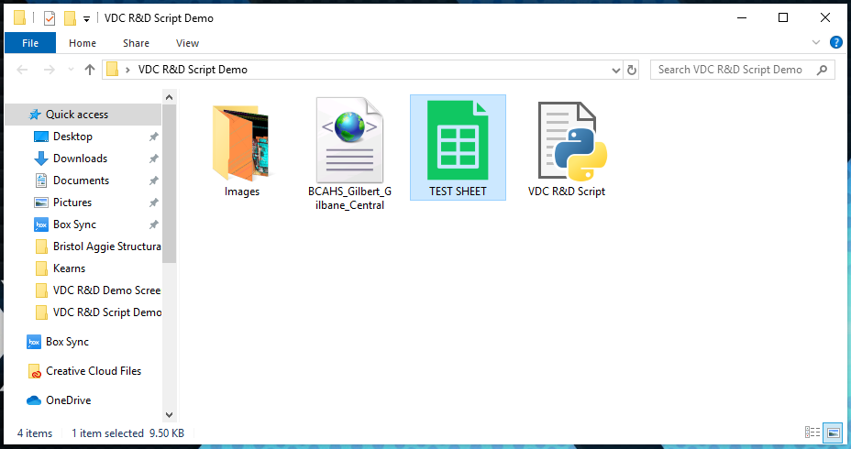
After running the program, go to the folder where you chose to save the Excel file. You should see a “.xls” file with the name you gave it. You must have Microsoft Office or an Excel Viewer to open this file.

Slide 13
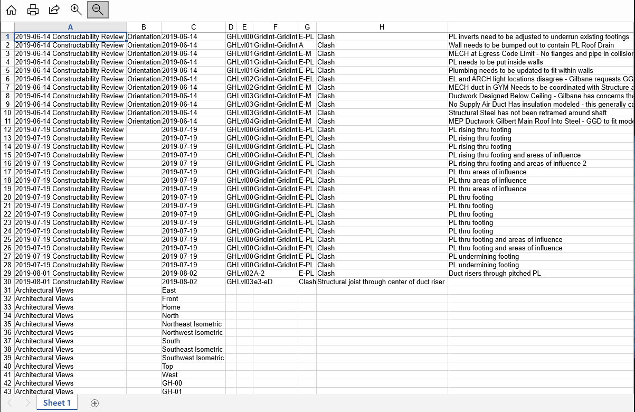
Open the Excel file and ensure that the information matches up. If it does not, it is usually all there, just shifted due to a formatting error in Navisworks. You can copy and paste this information straight from the Excel File to Smartsheet.com
I would suggest selectively copy and pasting information after checking if it is correct.

Slide 14
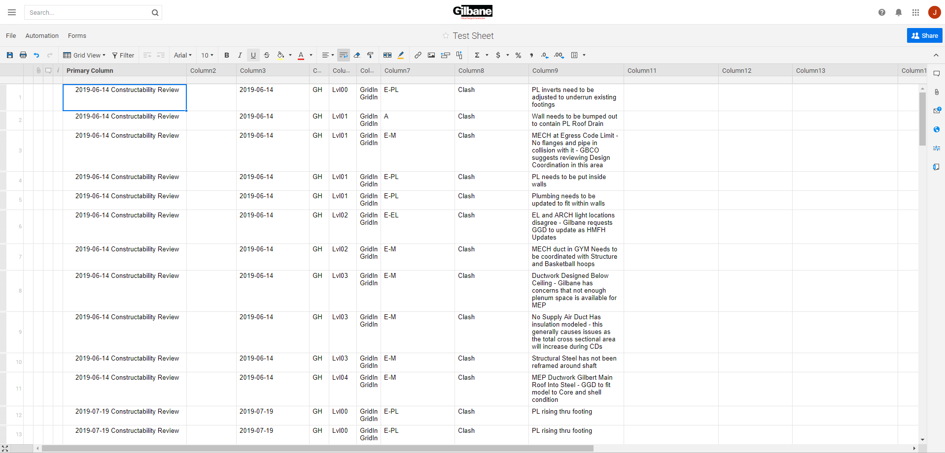
Here is the information from the Excel file in Smartsheets.
If the formatting is incorrect in the Excel sheet, moving it over to Smartsheet is a good time to correct any shifted information.

Slide 15
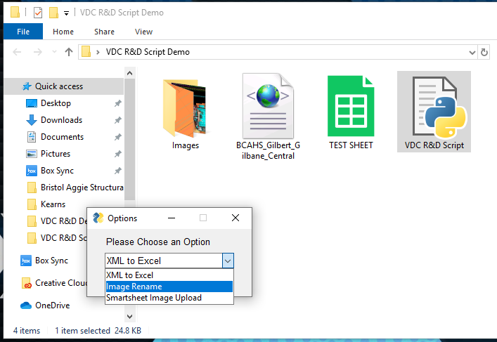
To rename all images with their corresponding viewpoint name, open the Python script and choose the “Image Rename” option at the first screen.

Slide 16
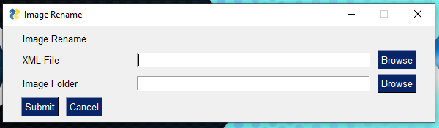
Image renaming only needs two pieces of information.
The XML file from Navisworks
The folder that contains all exported images from Navisworks
REMEMBER: the “.html” file still needs to be deleted

Slide 17
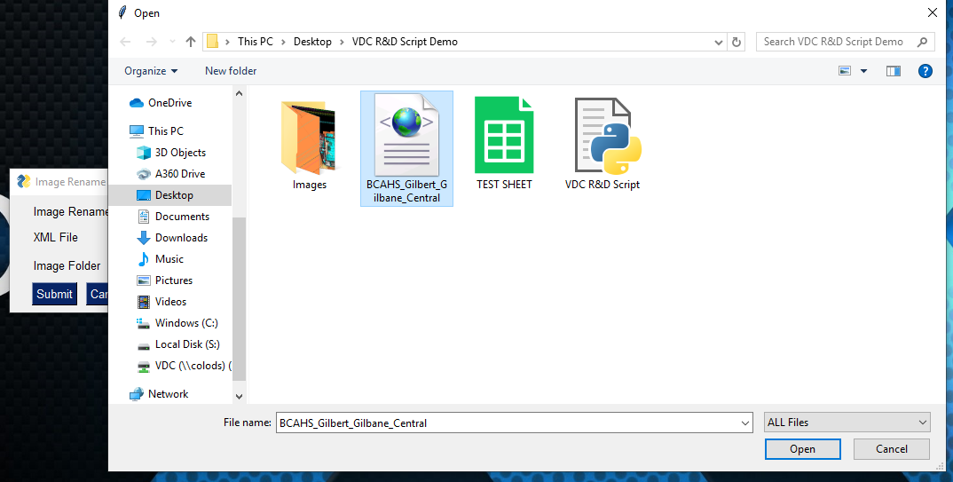
Use the “Browse” button to select the XML File from Navisworks and then click “Open” at the bottom right.

Slide 18
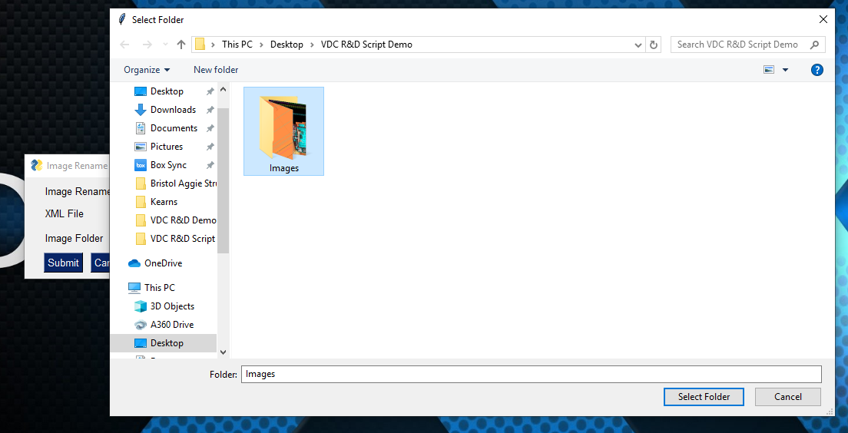
Use the “Browse” button to select the “Image Folder” and click “Select Folder” when ready.

Slide 19
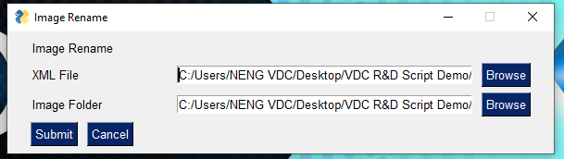
Here is what your program should look like.
If you add, remove, or change any viewpoints you must re-export both the image folder and the XML file.
When you are ready to rename the images, click “Submit” at the bottom left.

Slide 20
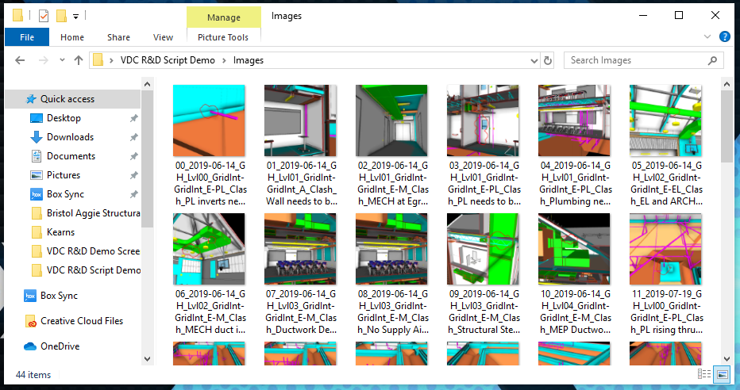
Here is what your image folder should look like. Each image is given a prefix with a number to ensure the order is the same as it appears in Navisworks

Slide 21
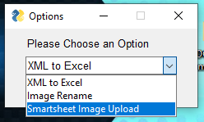
Now that you smartsheet is populated with the information from the Excel file and all your images are renamed, it is time to upload the images to Smartsheet.
I highly suggest creating a “middle man” smartsheet to provide quality control between this program and your “master” Smartsheet. You can copy entire rows from one sheet to another inside of Smartsheet

Slide 22
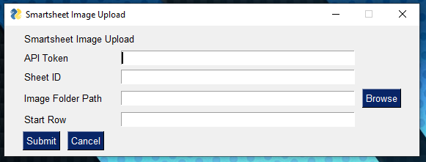
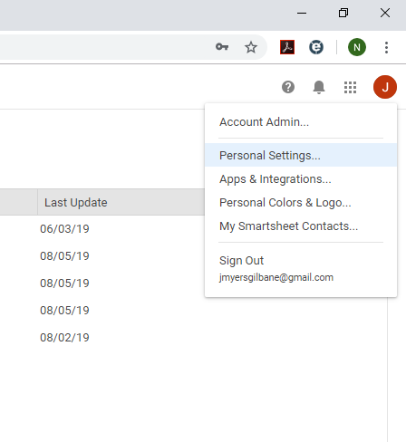
Here is the information needed to upload images to Smartsheet.
To create an API Token, go to Smartsheet and go to “Personal Settings” under your account. This is near the top-right of your screen.

Slide 23
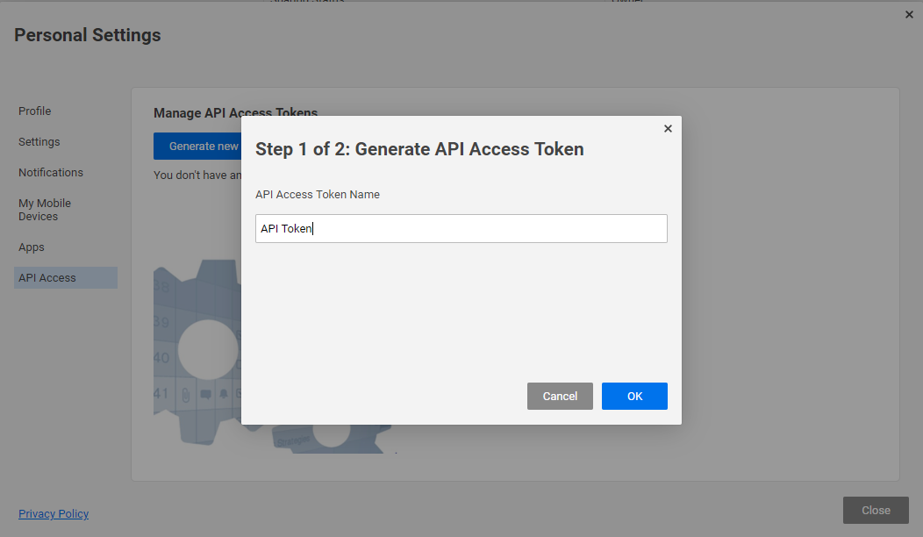
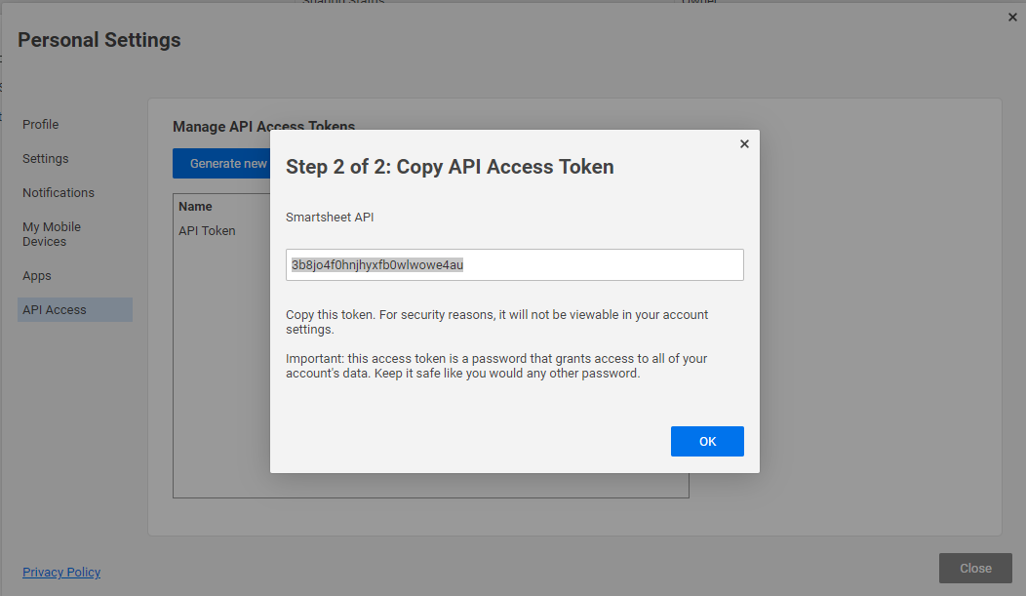
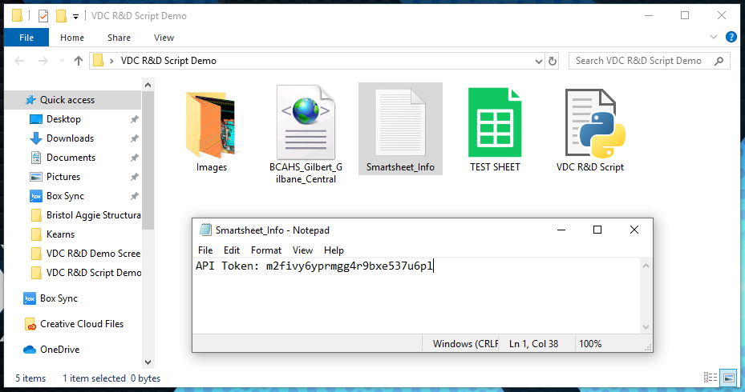
Under “Personal Settings”, go to “API Access” at the bottom of the list.
Enter a name for the API Token, this has no impact on anything other than giving it a name.
Next, copy the generated API Token and save it somewhere you can find later. I like to create a new text document and just paste it in there. You could add it to a sticky-note or anything. Just put it somewhere you can find it and copy it later on.

Slide 24
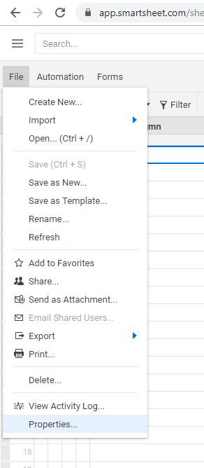
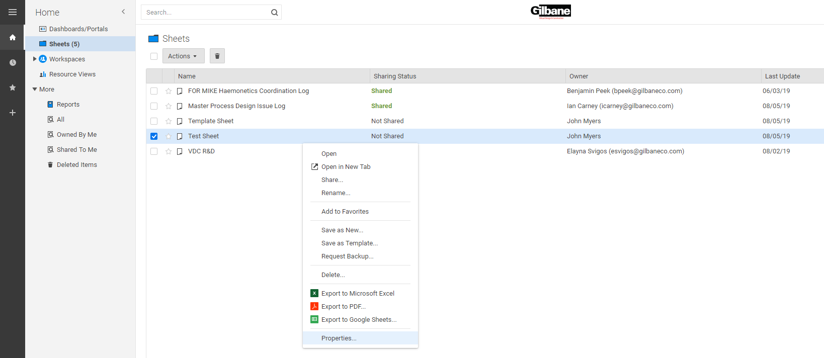
Paste your API Token in the first box labelled “API Token”
Next, get the Sheet ID of the sheet you want to upload your images to.
The Sheet ID can be found under “Properties” either through “File >> Properties” while viewing the sheet, or by right-clicking on the sheet name on the Smartsheet homepage.

Slide 25
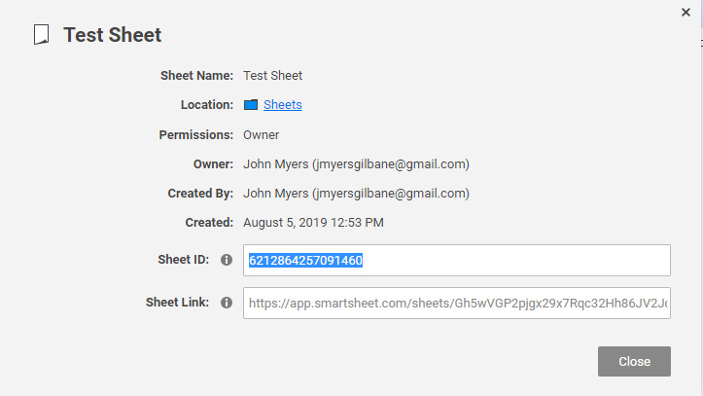
After going to sheet properties, the Sheet ID will be towards the bottom of the pop-up window. You can save this in an easily accessible place for later. I suggest putting it in the same place that you saved your API Token.

Slide 26
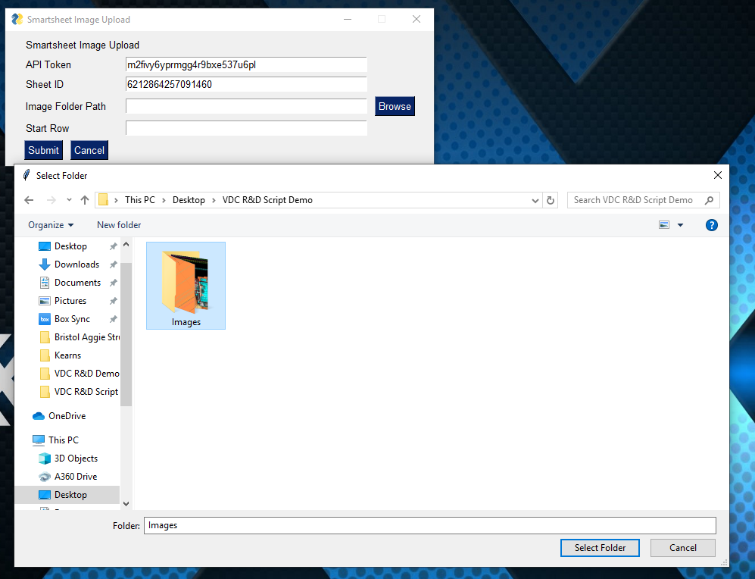
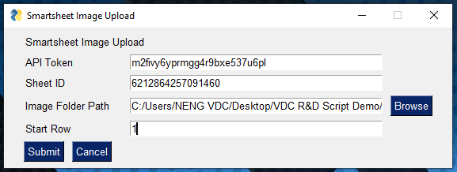
Next, use the “Browse” button to select the folder containing all the images to be uploaded. Click “Select Folder” when ready.
Determine what row to start the upload. Row 0 does not exist, so row 1 is the lowest you can go. All images are uploaded sequentially, so your smartsheet should have all the viewpoint information already documented before you try to upload any images using this tool.
If you upload images to blank space, it will run out of rows to upload to and it will fail.

Slide 27
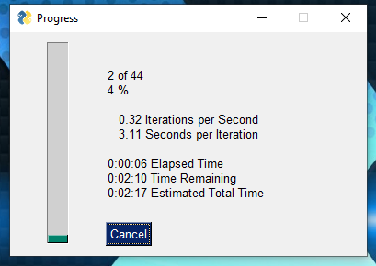
When you are ready, hit “Submit”. The previous window will close and the window pictured above will appear after 5 seconds. This window updates every 5 seconds after an image is uploaded.
It takes 5 seconds for each image to be uploaded, but you can just minimize this progress meter.

Slide 28
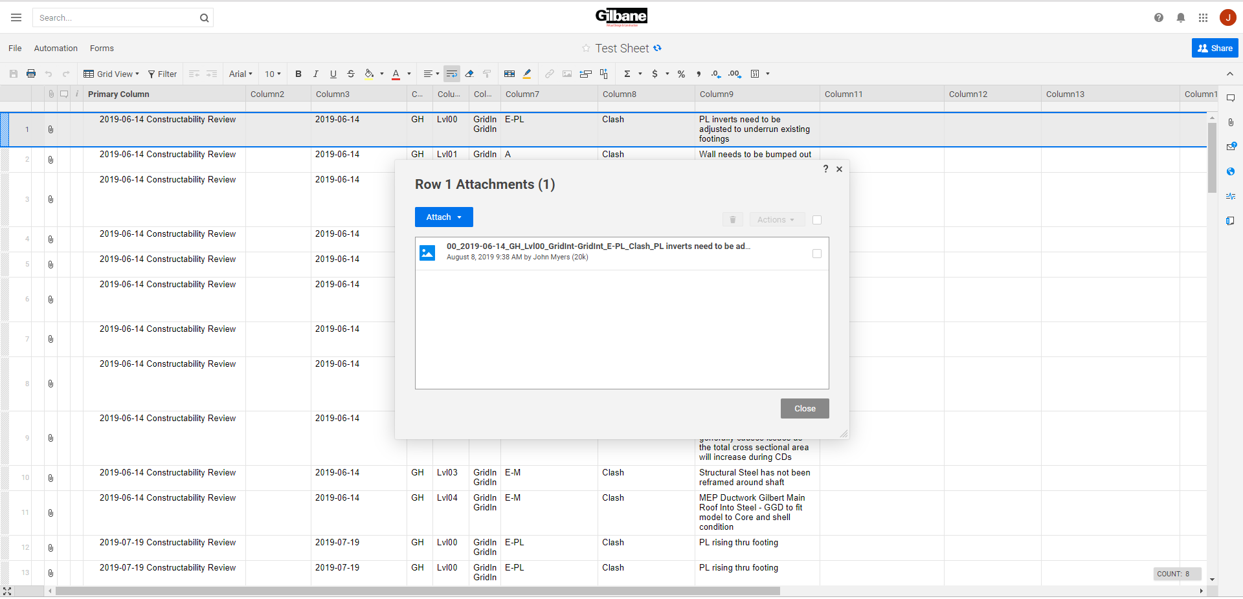
Finally, here is what your sheet will resemble when done.

